Slide 1
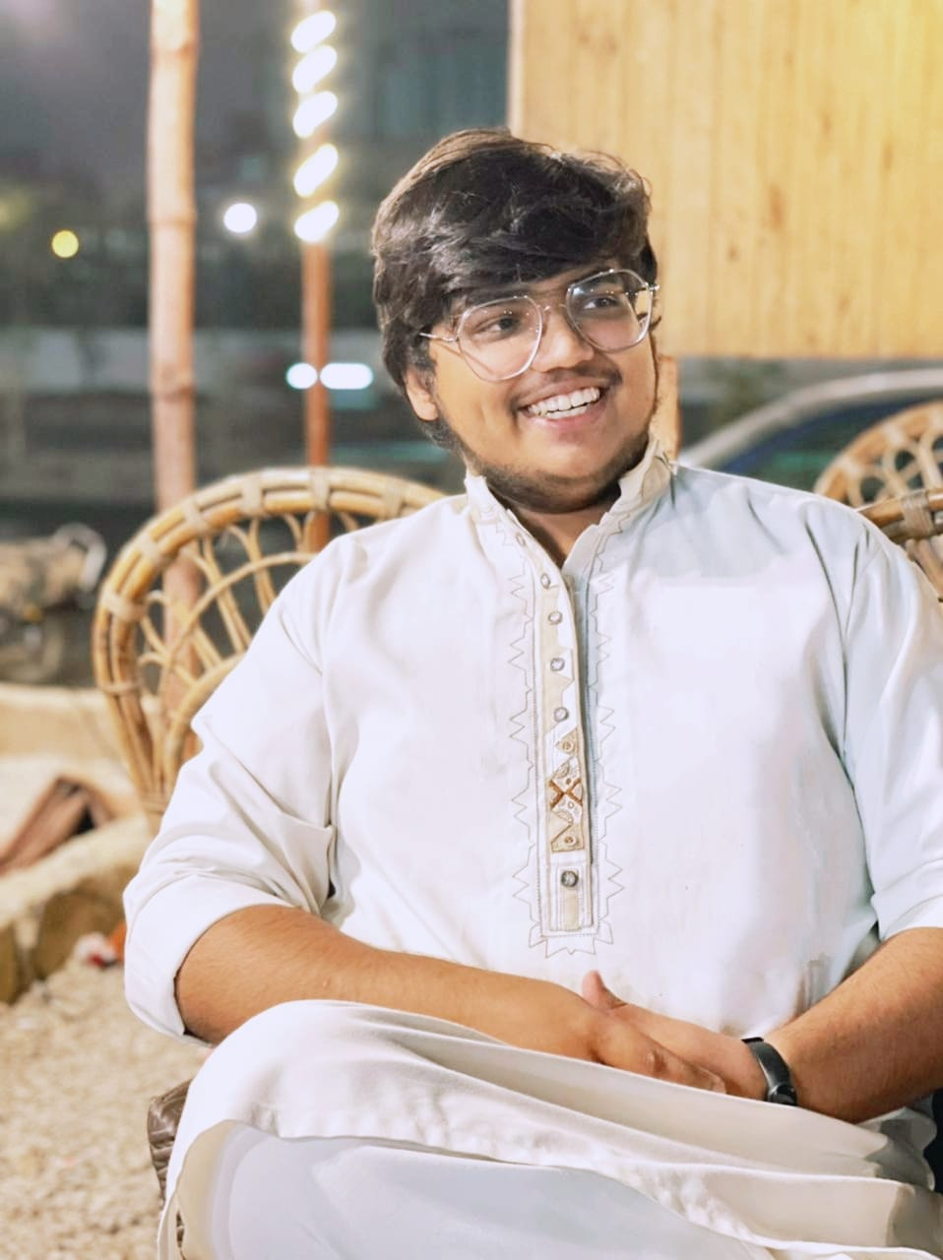
Personal Profile Name: Abdul Rahman KhaN ERP: 24084

Slide 2
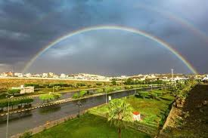
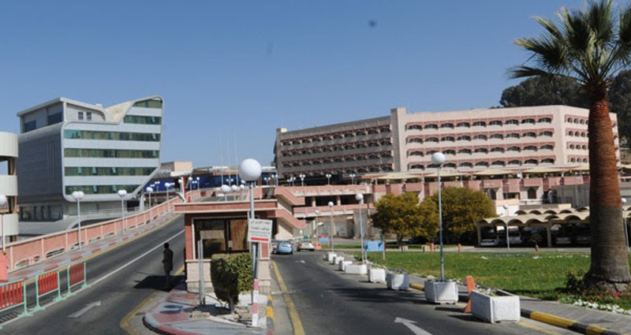
Early Days of my life
Born in Taif, Saudi Arabia On 24 January, 2002.

Slide 3
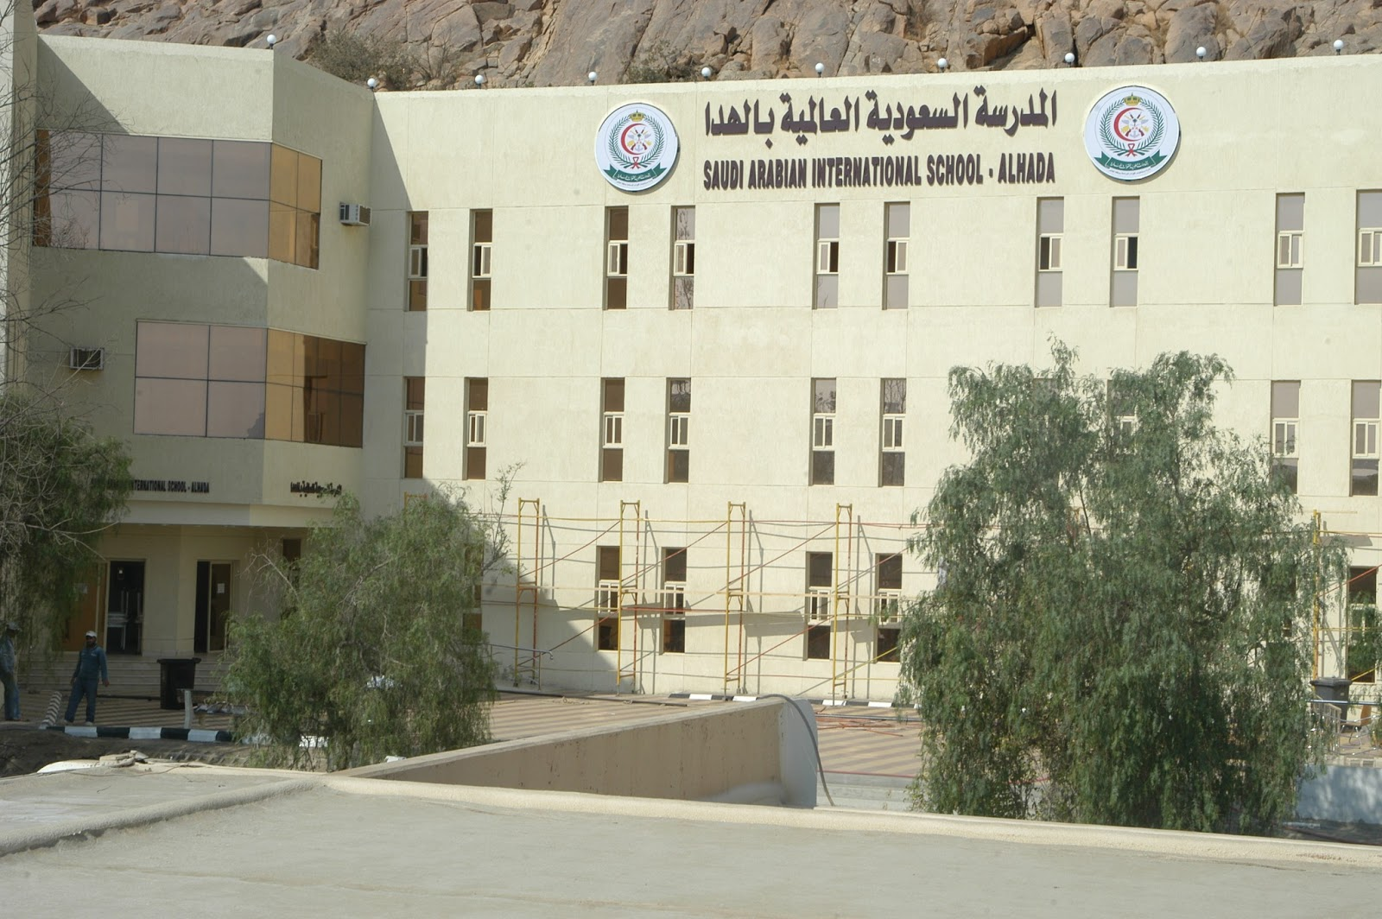
Primary Education
Saudi Arabian International School, Al Hada

Slide 4
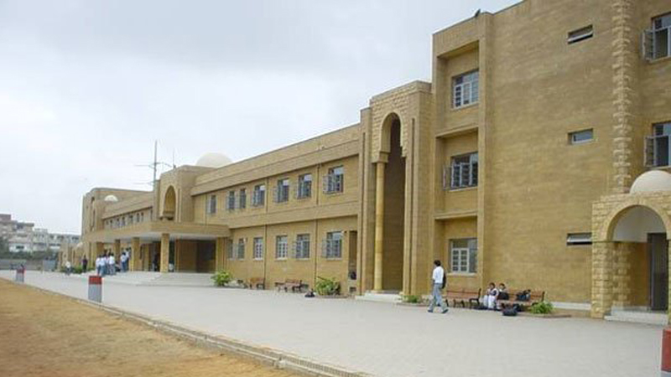
Higher education
Karachi Grammar School

Slide 5


Work Experience
The co-founder of an online store DJ tech (a startup by me and a partner to learn how to operate and manage a business.)
Founder and Ex Ceo of Customized Gift Items.
DJ TECHH

Slide 6


Skills
A very organized person with excellent problem solving skills.
Have good public speaking and communication skills which are reflected by my debates and other awards.
A very dedicated and punctual person.
A fast learner and possess good critical thinking skills.
Possess good research skills as I have written a research paper.
Possess good leadership and decision making skills as I was the Headboy of my school

Slide 7
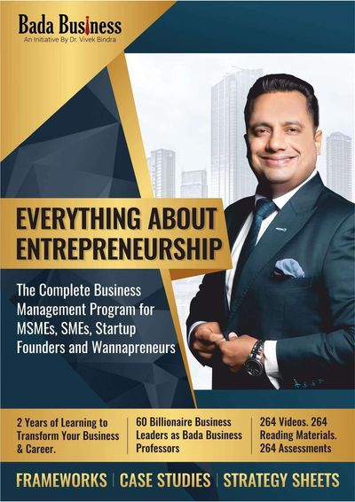
Courses and Certification
Completed a course of 2 years known as EVERYTHING ABOUT ENTREPRENEURSHIP.
Currently enrolled in 2 courses of the ecommerce markets to learn the dynamics of Amazon and Quick books.

Slide 8
Awards
Certificate of merit in BSS( 2017,2018,2019)
WSC Global round qualifier.
CAIE ALEVELS distinction in urdu

Slide 9

COMMUNITY SERVICE
Team head at Saiban welfare Association for helping out visually impaired people
Project head at drives for APWA COLLEGE

Slide 10
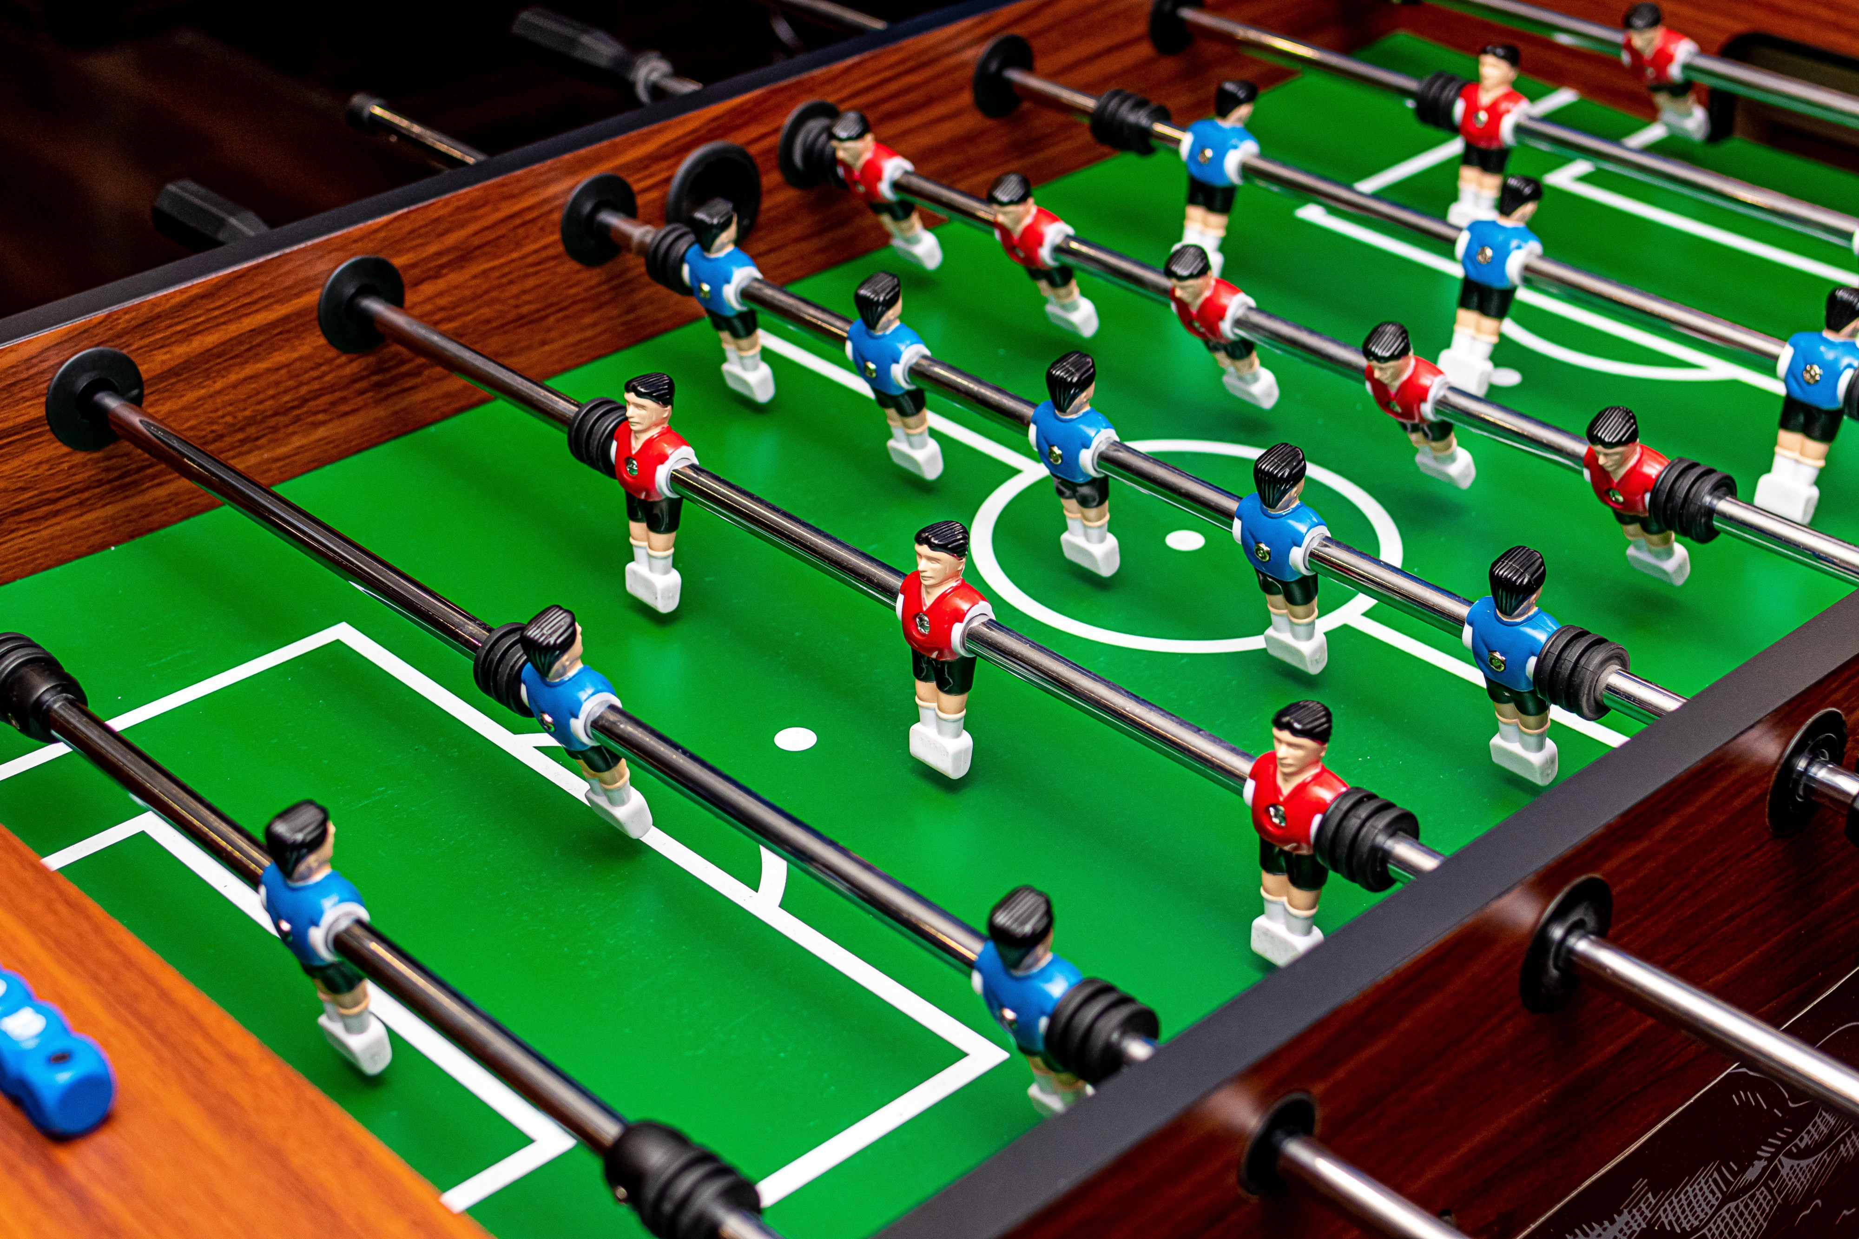
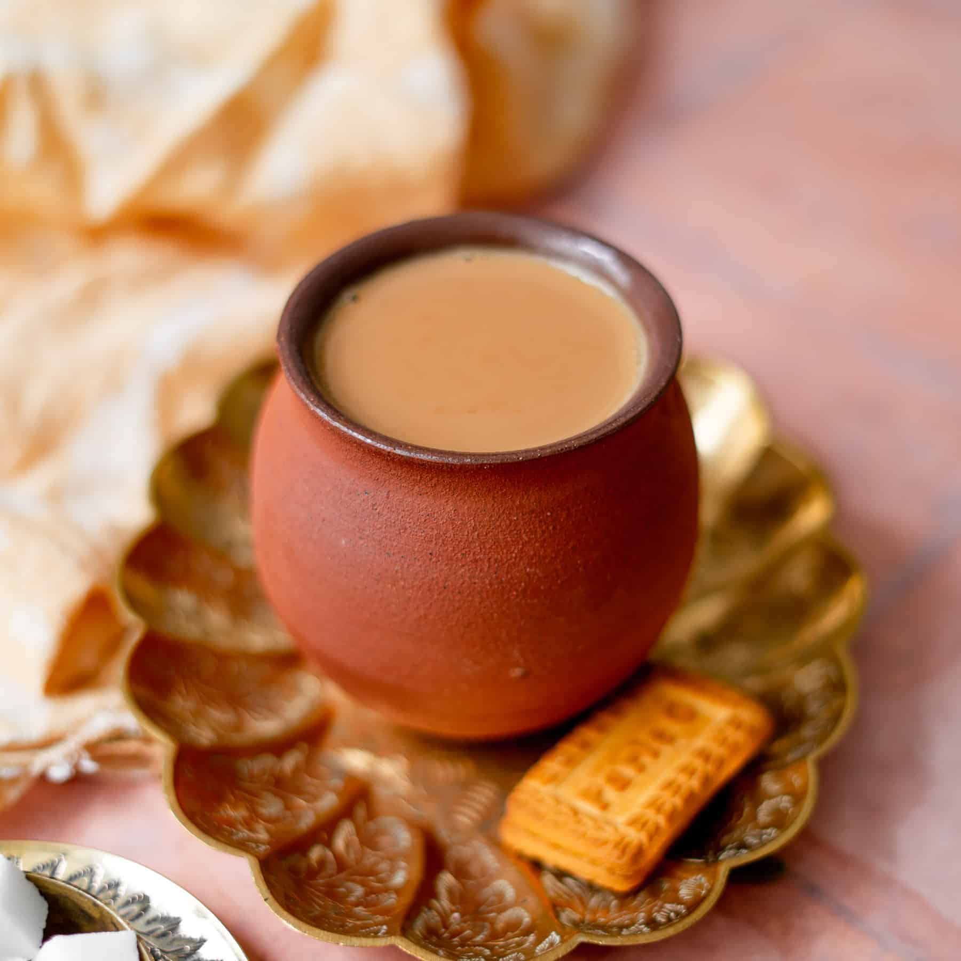
Hobbies
Reading books
Watching movies.
Playing foosball
Horse riding
Drinking chai

Slide 11
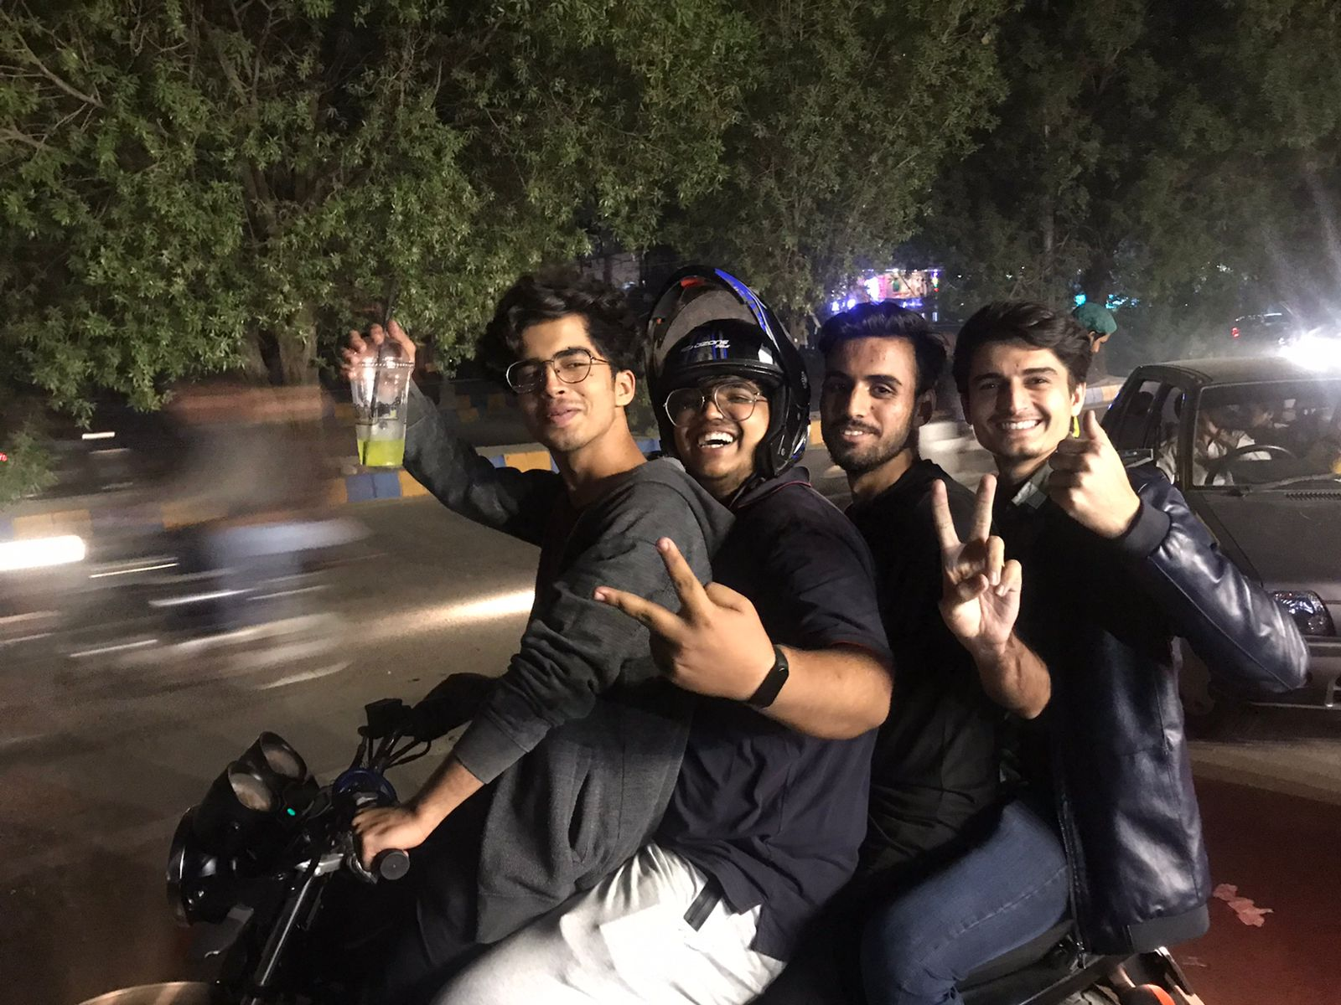
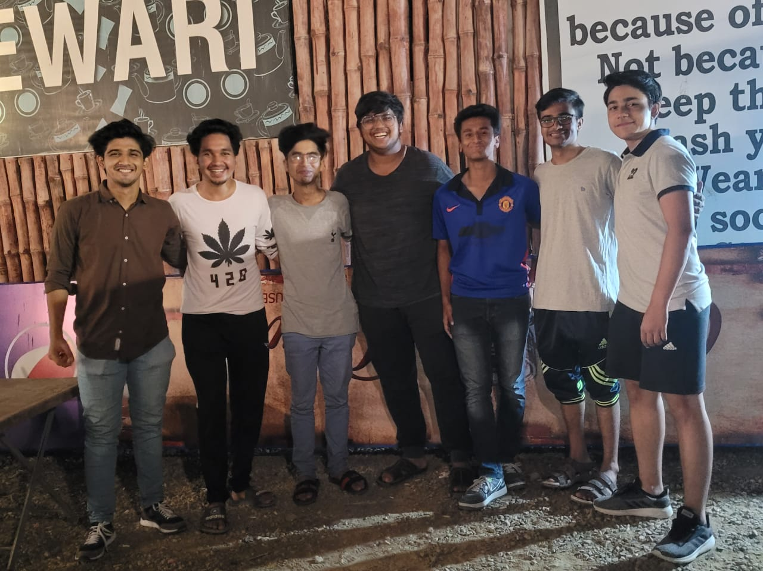
friends
I personally believe that friends are a very integral part of a person’s life.
I feel very grateful that I have really good friends.

Slide 12
Thank you so much

